Slide 1
Crop Yield Prediction
Group Number: 294
Vishnu Pajjuri
Aditya Dubey
Amrutha Gowda

Slide 2
CONTENTS
Introduction
Pre-processing
Data Visualization
Extracting Features from Timestamp
Data Validation Split
Models
Linear Regression
Decision Tree
Random Forest
XG Boost
Neural Network
Comparison of Models
Yield Production Graph
Conclusion

Slide 3
Introduction
A new fast food chain is seeing rapid expansion over the past couple of years. They are now trying to optimize their supply chain to ensure that there are no shortages of ingredients.
Predicting the output of each food processing farm over the next few years could further increase the efficiency of their current supply chain management system.

Slide 4
Data set
Size of our data is around 2080580 with 17 attributes.
Dependent variable:
Yield
Independent variables:
Farm ID
Date
Ingredient Type
Operations_commencing_year
Num_processing_plants
Farm_area
Farming_company
Deidentified_locatione
Timestamp
Temp_obs
Cloudiness
Wind_direction
Dew_temp
Pressure_sea_level
Precipitation
Wind_speed

Slide 5
DATA Preprocessing
Decreased the size of memory by 72% using memory optimization
Converted date, timestamp to datetime format
Checking and clearing duplicates
135568 duplicate records has different yield values
Dropping the duplicates by copying to another data frame
Take average and replace the mean for duplicate values
Merge the records back with original data
148920 records dropped as whole rows are duplicated
Finding percentage of Null values
Dropped columns with missing value percentage > 40%
Imputation is performed for records with missing values < 40% using mode.

Slide 6
Merge operation on Data
Farm_data + test -> initial_merged_test (+ weather_test) -> final test
Farm_data + train -> initial_merged_train (+ weather_train) -> final train
Removed outliers
Dropping unnecessary columns
Index, Date, Timestamp and weekday
Label Encoding done for categorical columns

Slide 7
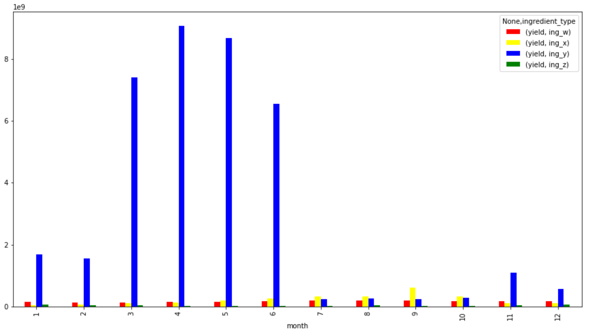
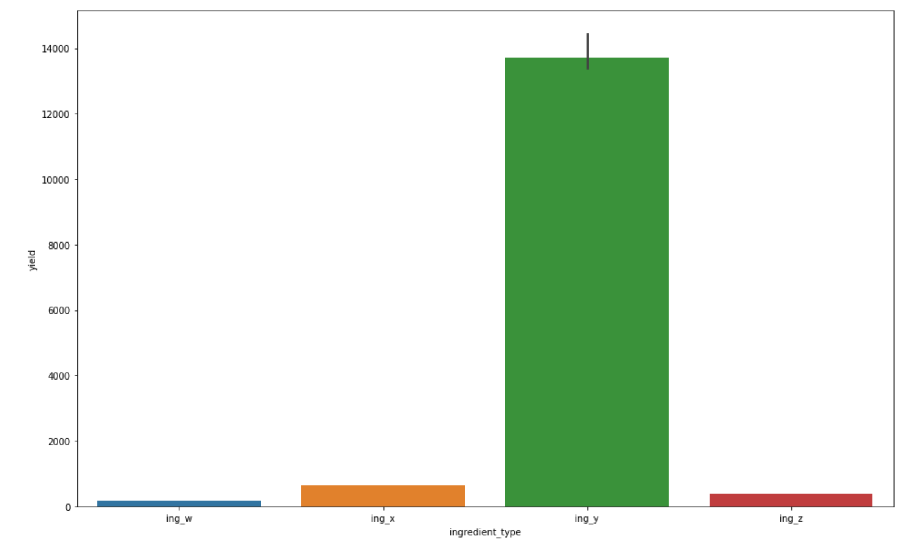
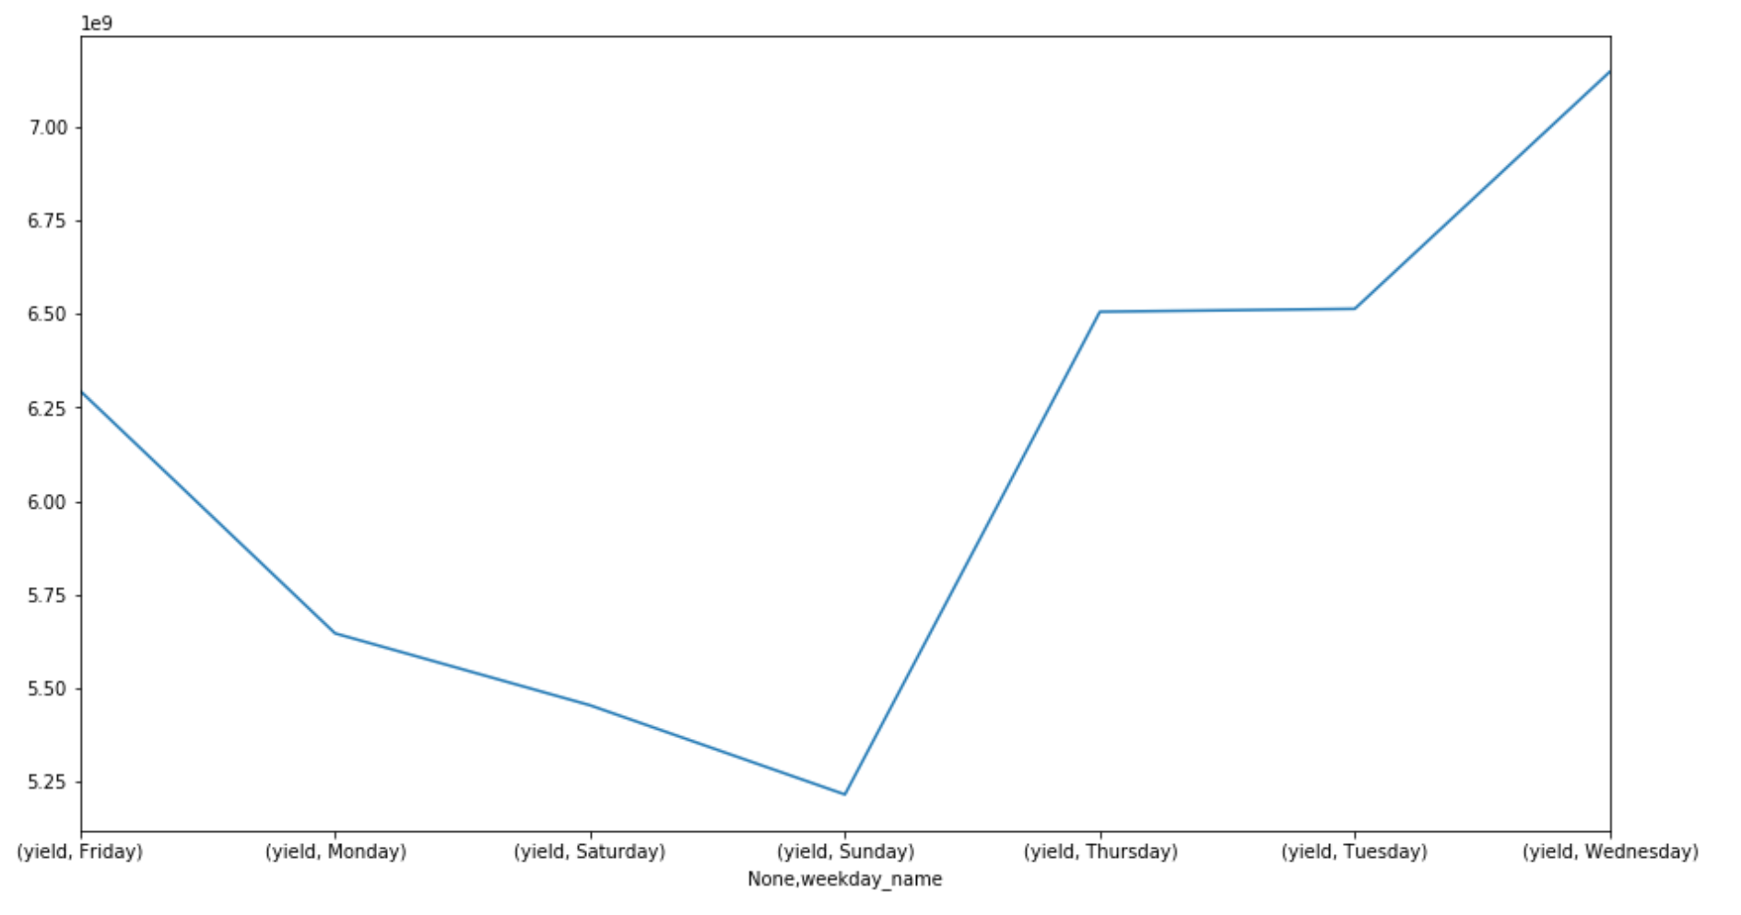
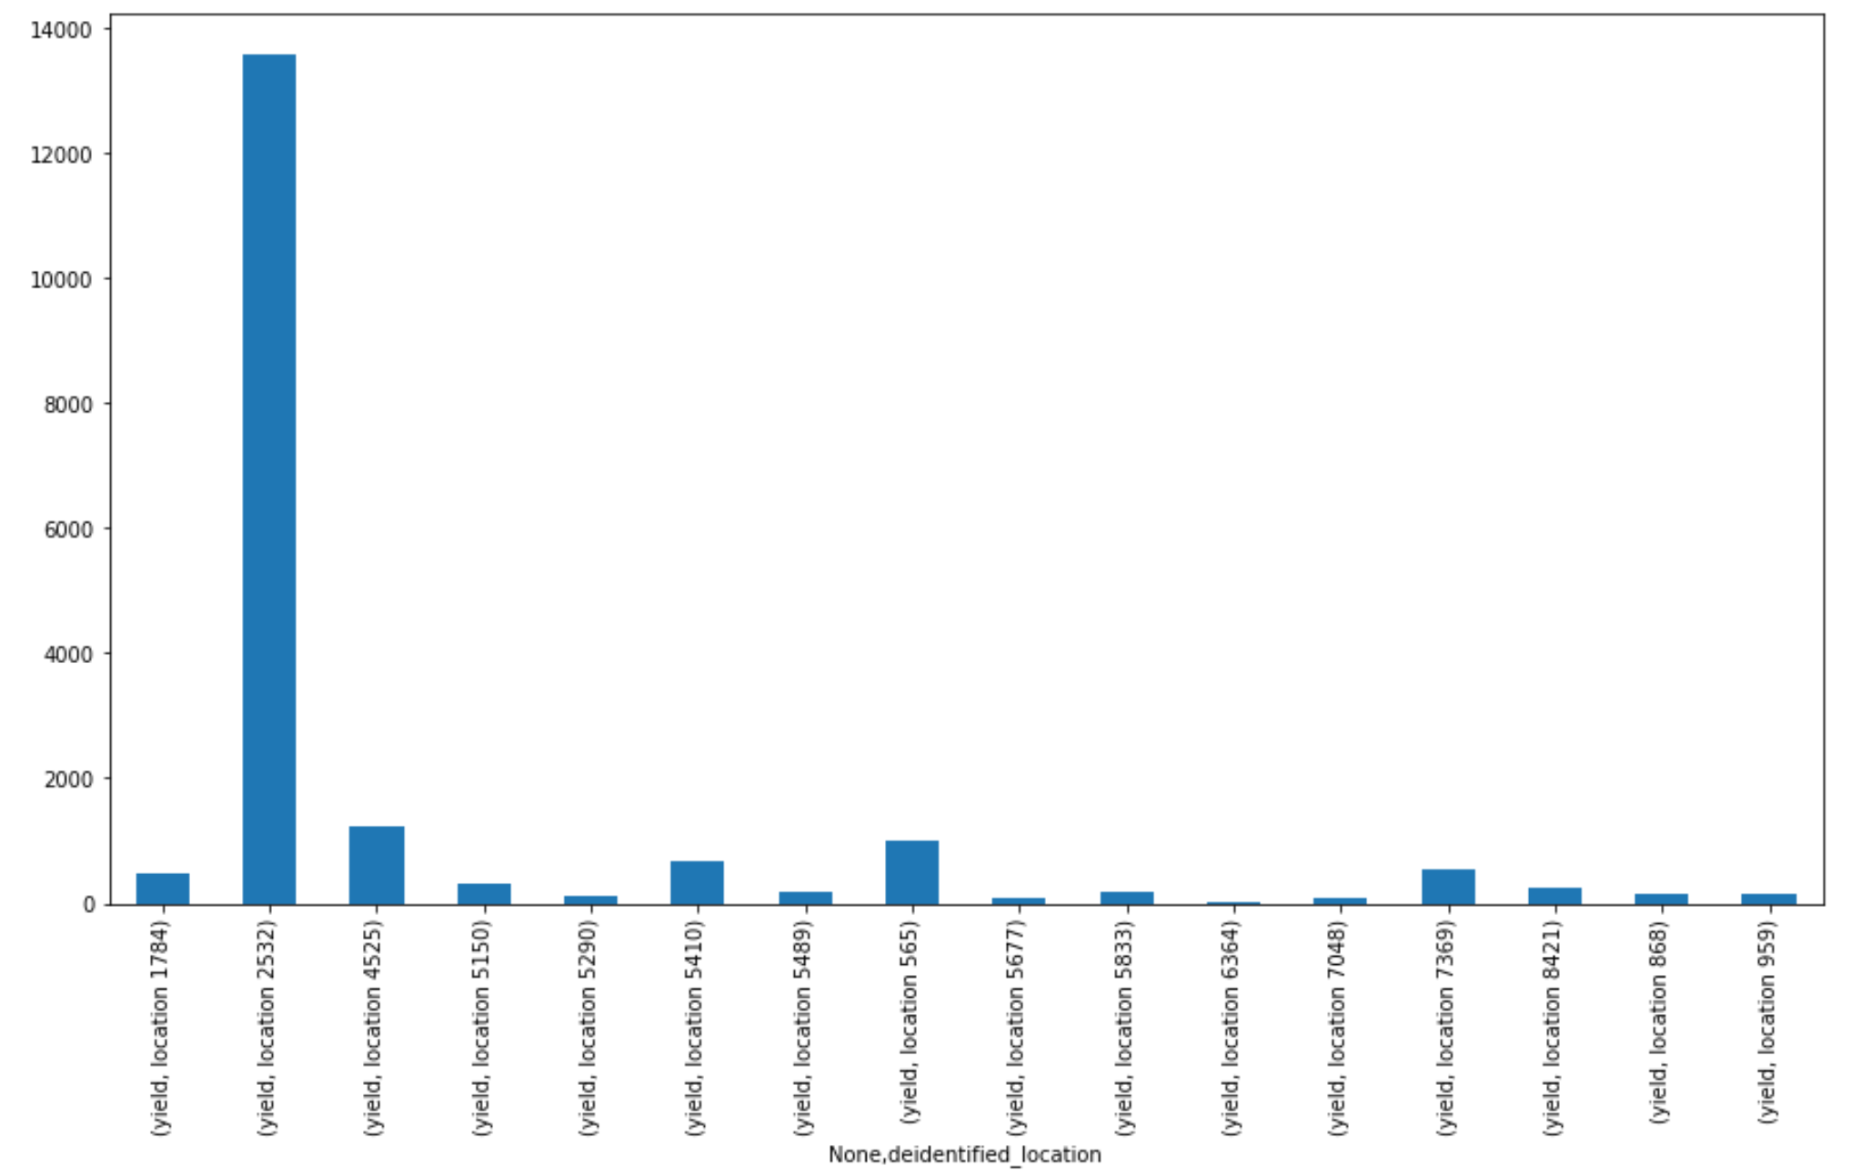
Data Visualization
Yield Plots
Ingredient_type
Month-wise with Ingredient type
Location-wise
Week-wise

Slide 8
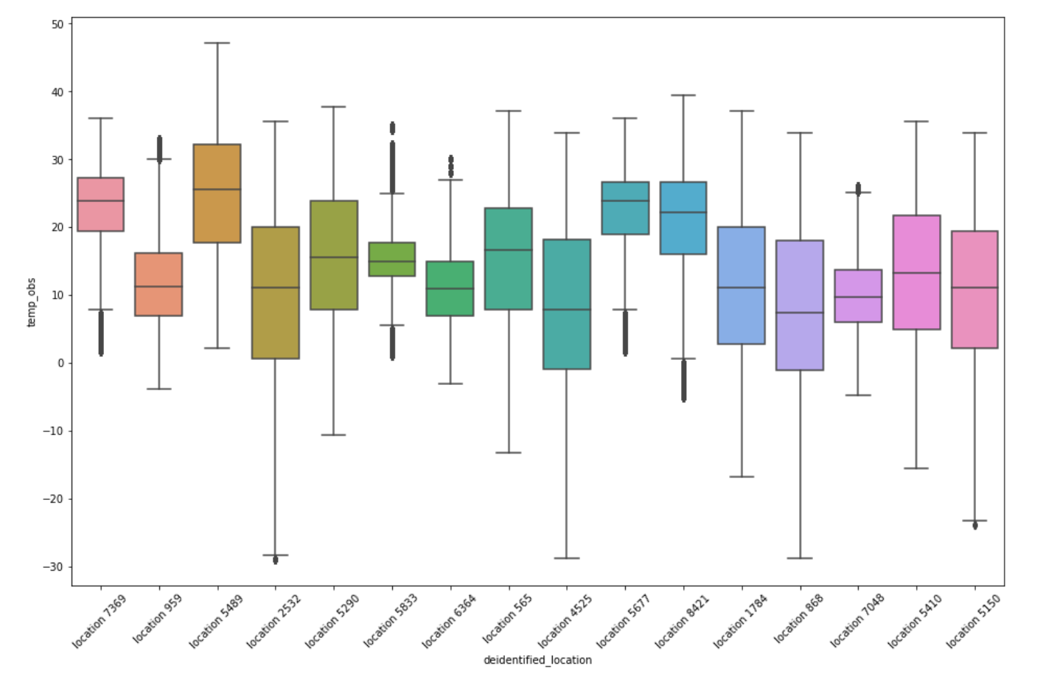
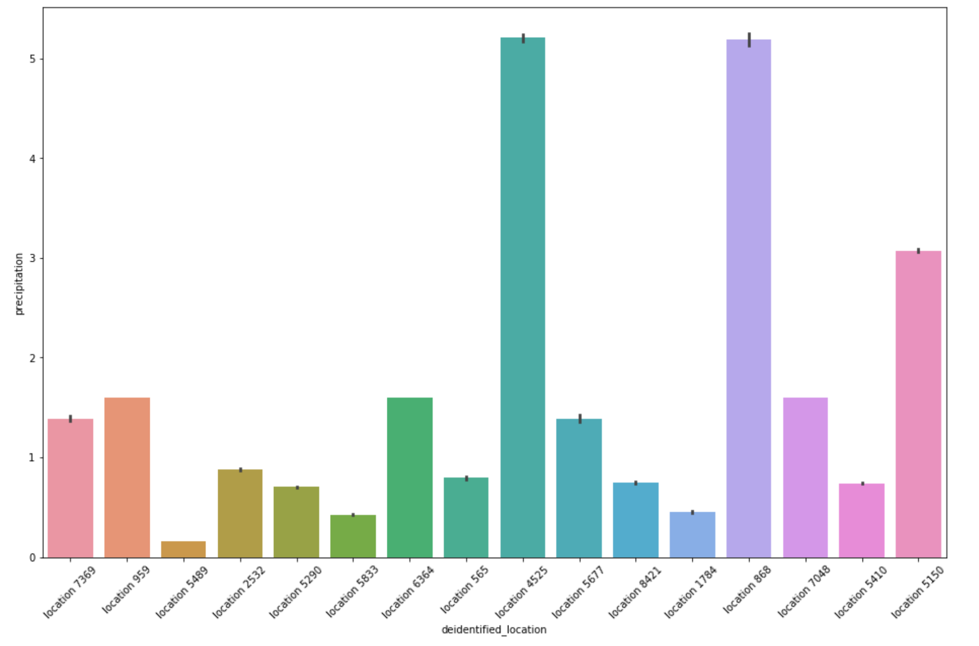
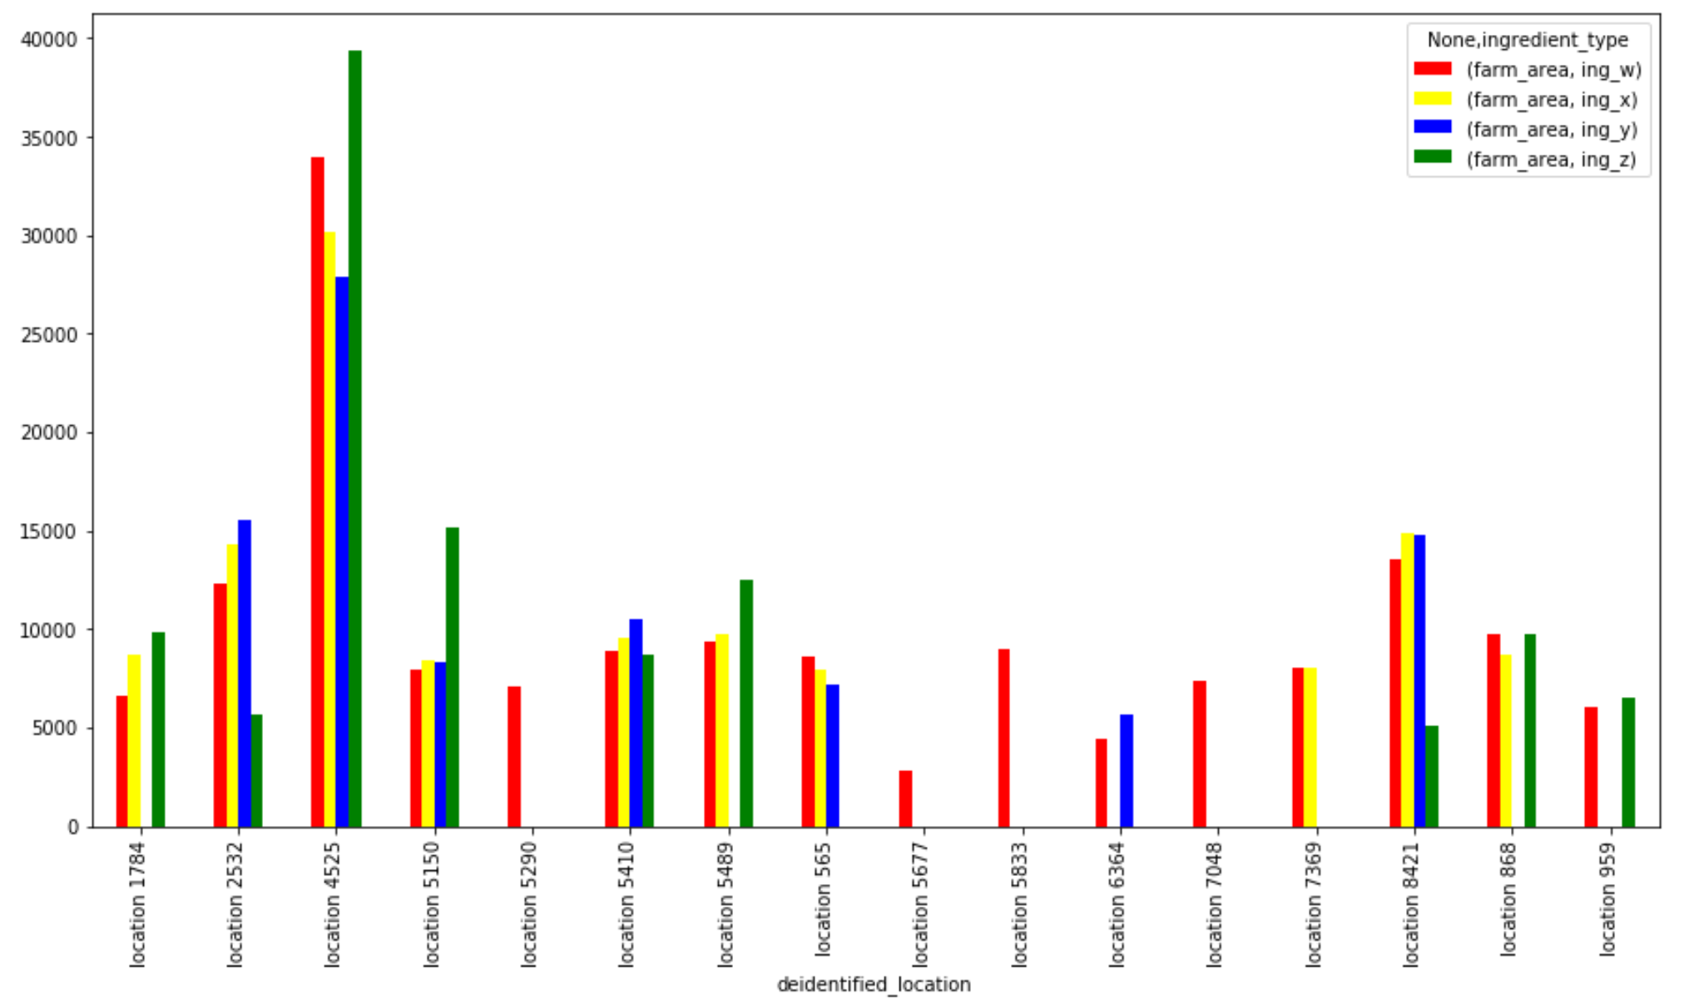
Location-wise Visualization
Temperature Observed For The Year 2016
Farm area and ingredient
Precipitation

Slide 9
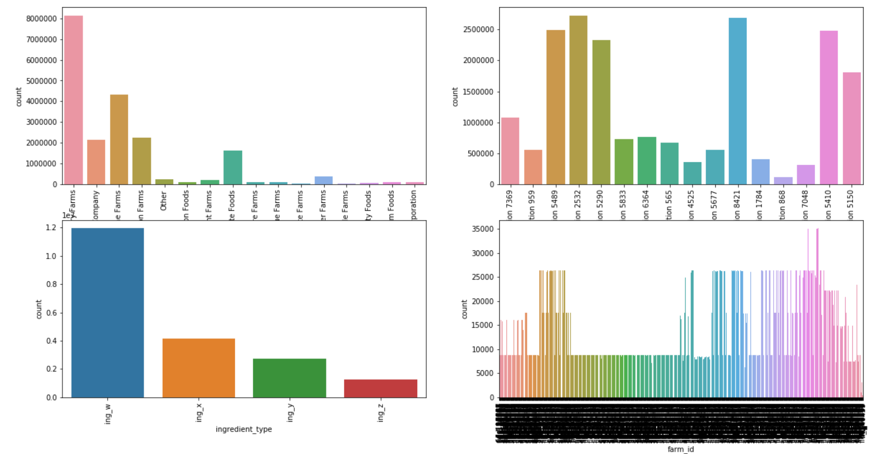
Count plot

Slide 10
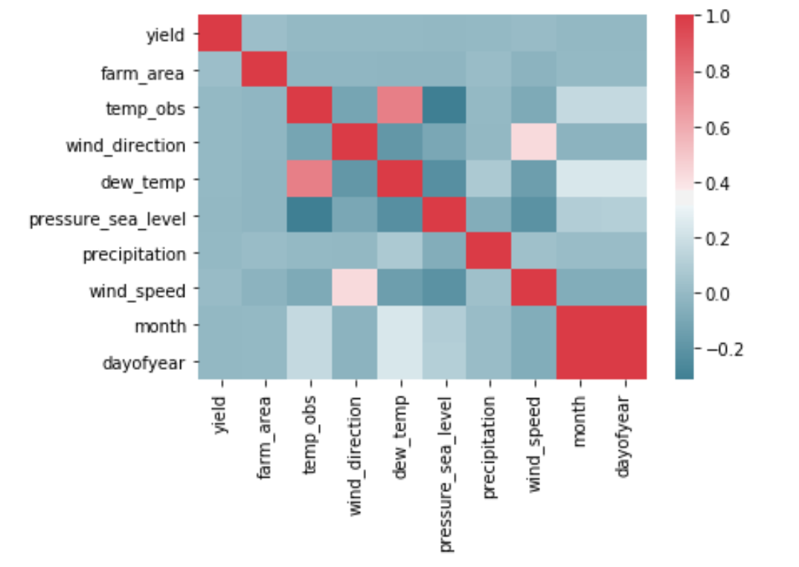
Heatmap

Slide 11
extracting Features from Time stamp
Time Stamp: Extracting features from datetime as weekday, day_name, dayofyear, day, month, is_month_end, is_month_start
Weekend or Weekday: Appending weekend with 0 and weekday with 1
Morning Evening Night: Segregated time into categorical variables

Slide 12
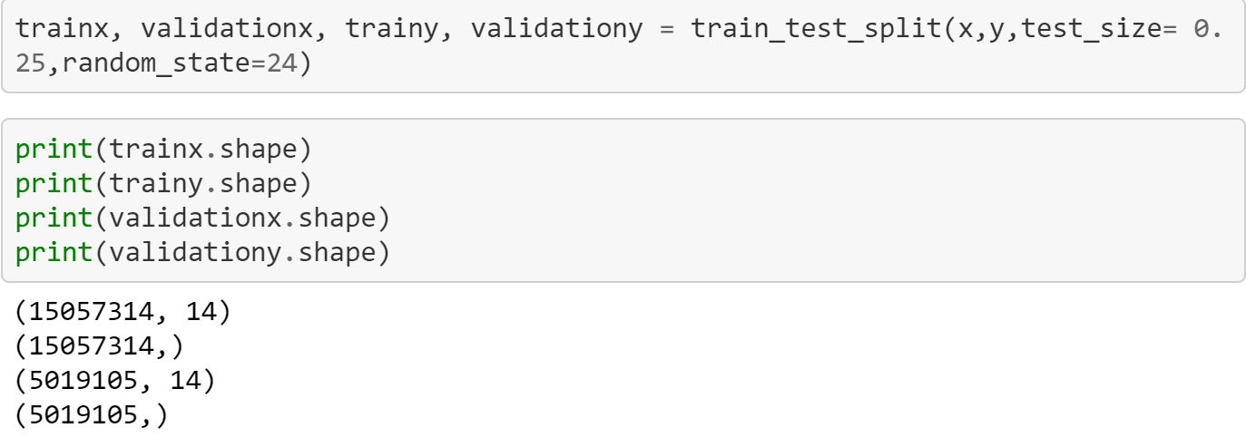
DATA VALIDATION SPLIT
Hold out evaluation is performed considering the size of data
Data split into train -75% and validation - 25%

Slide 13
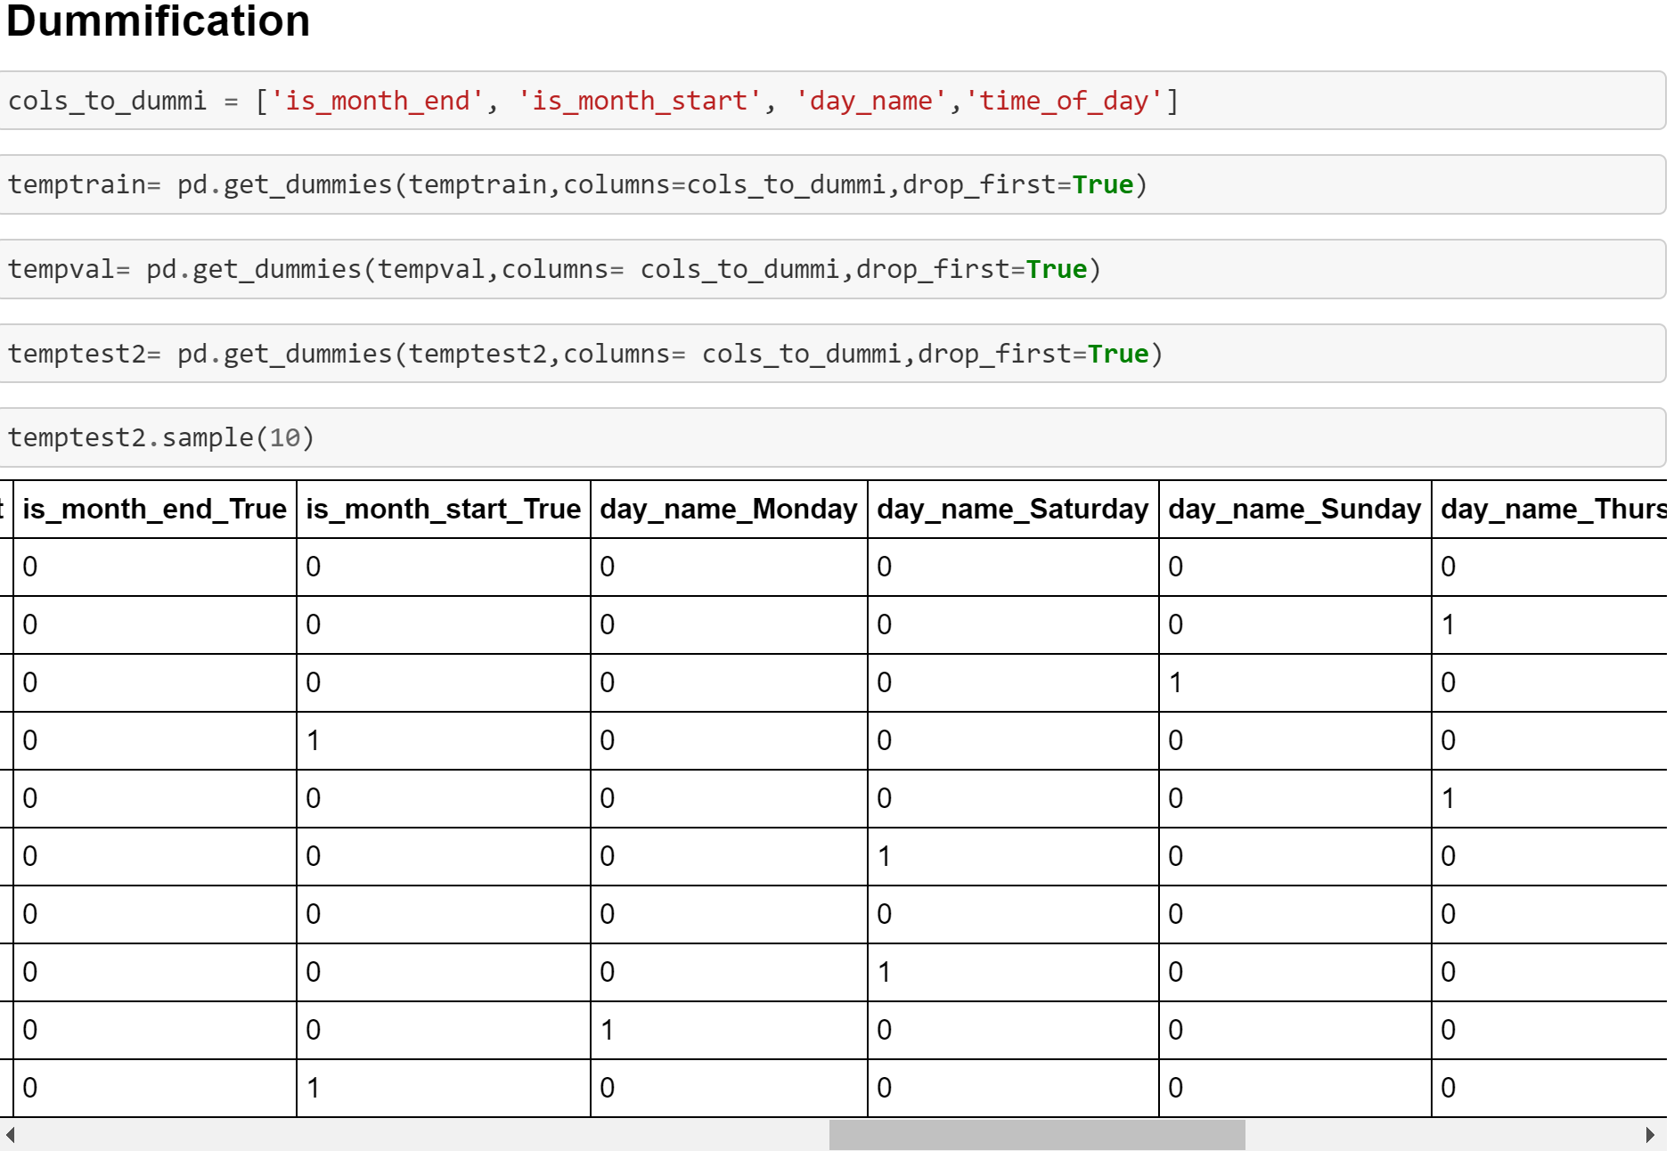
MODELS
REGRESSION MODEL
Dummification columns: is_month_end, is_month_start, day_name, time_of_day

Slide 14
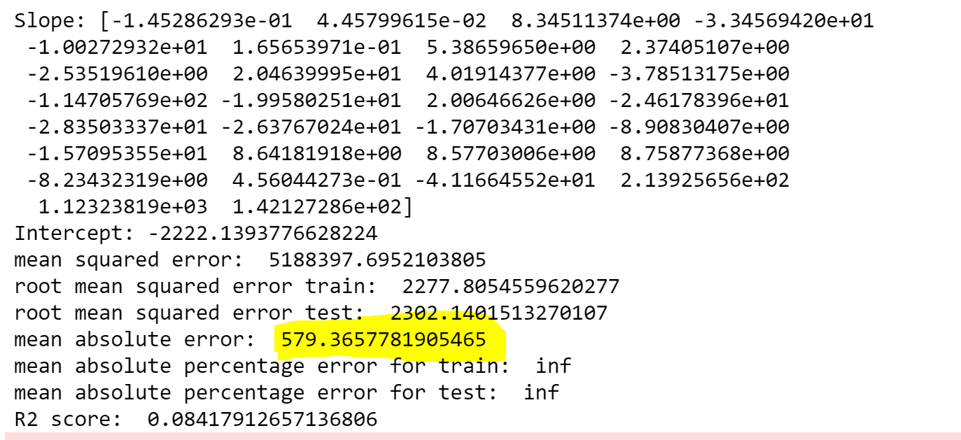
Linear Regression model

Slide 15
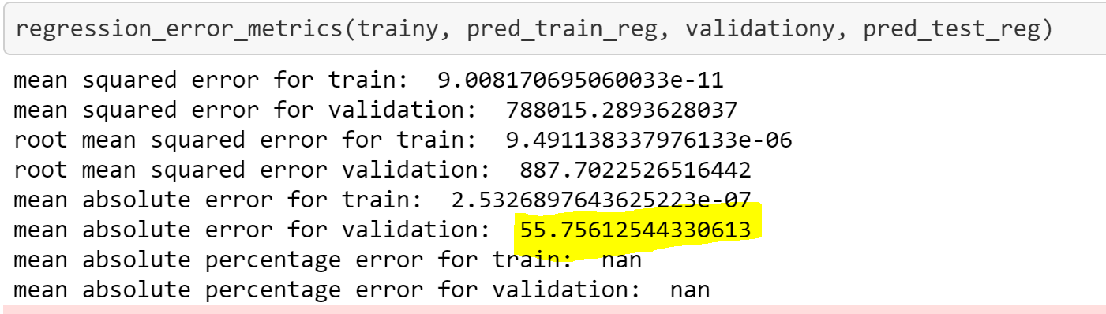
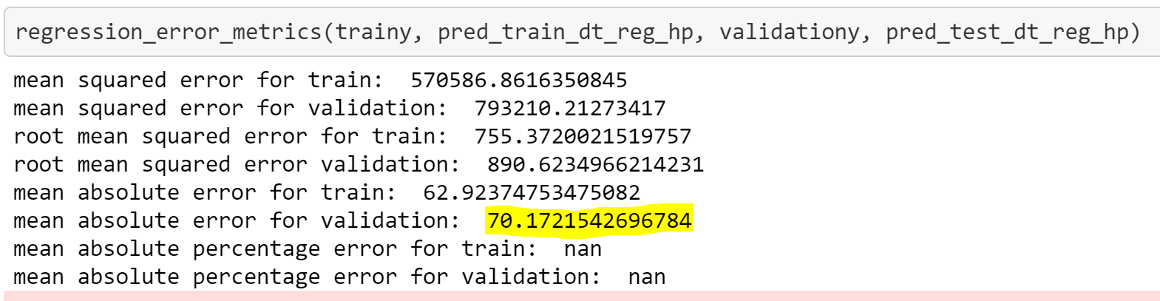
Decision Tree
Without Outliers
Hyperparameter

Slide 16
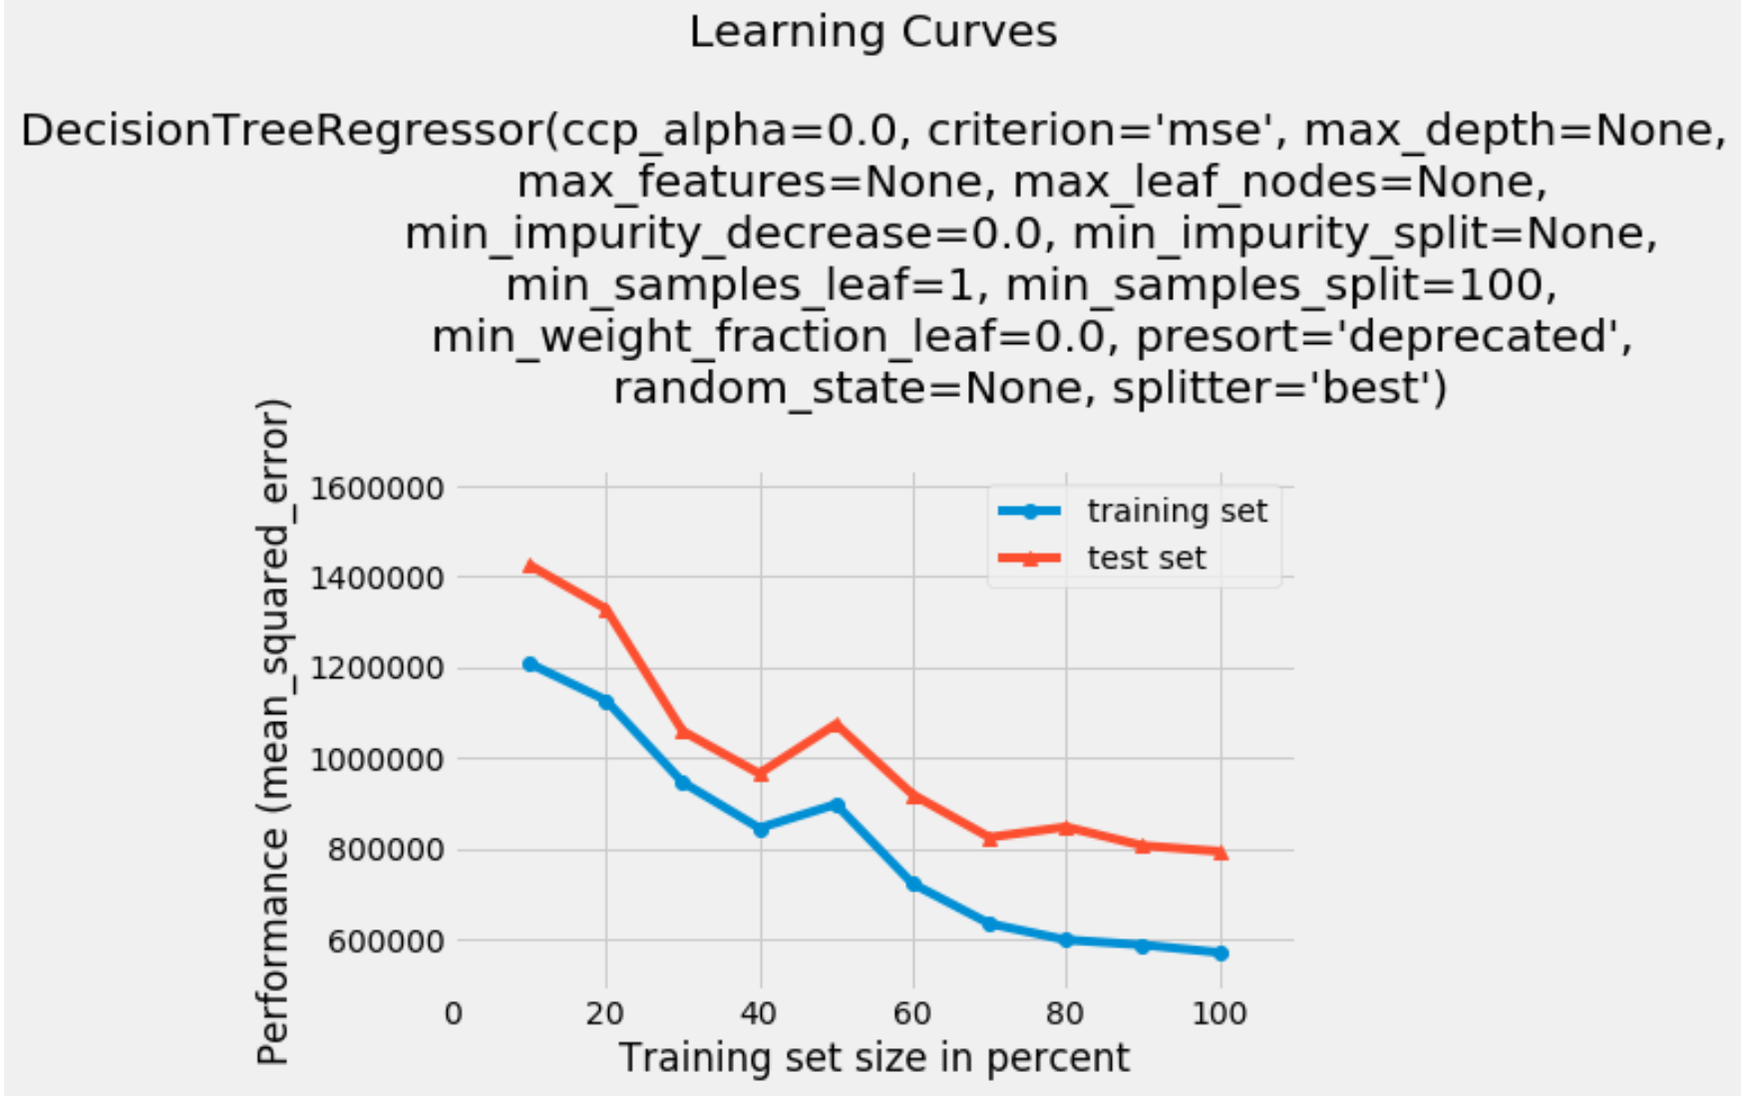
Learning Curve

Slide 17
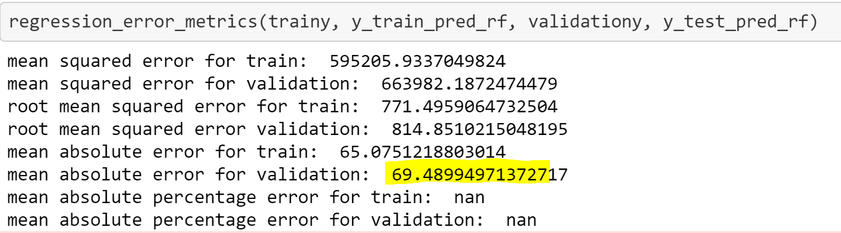
Random forest

Slide 18
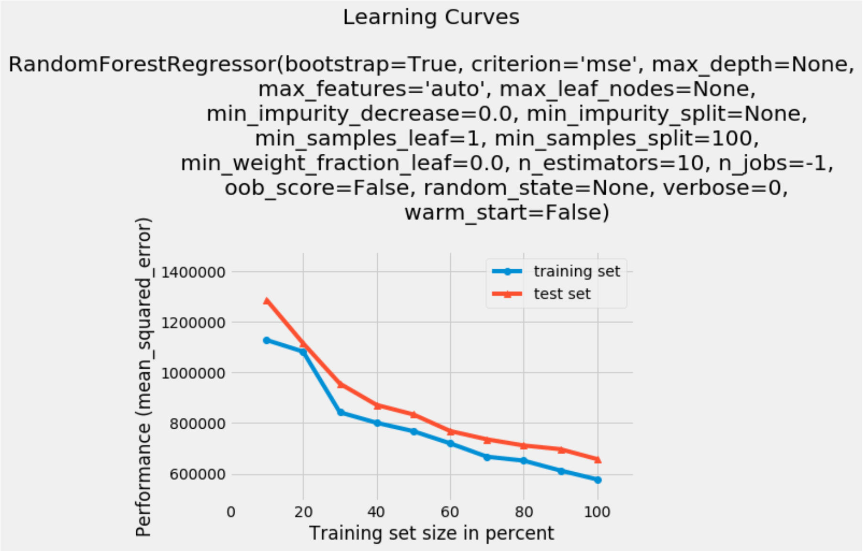
Learning Curve

Slide 19
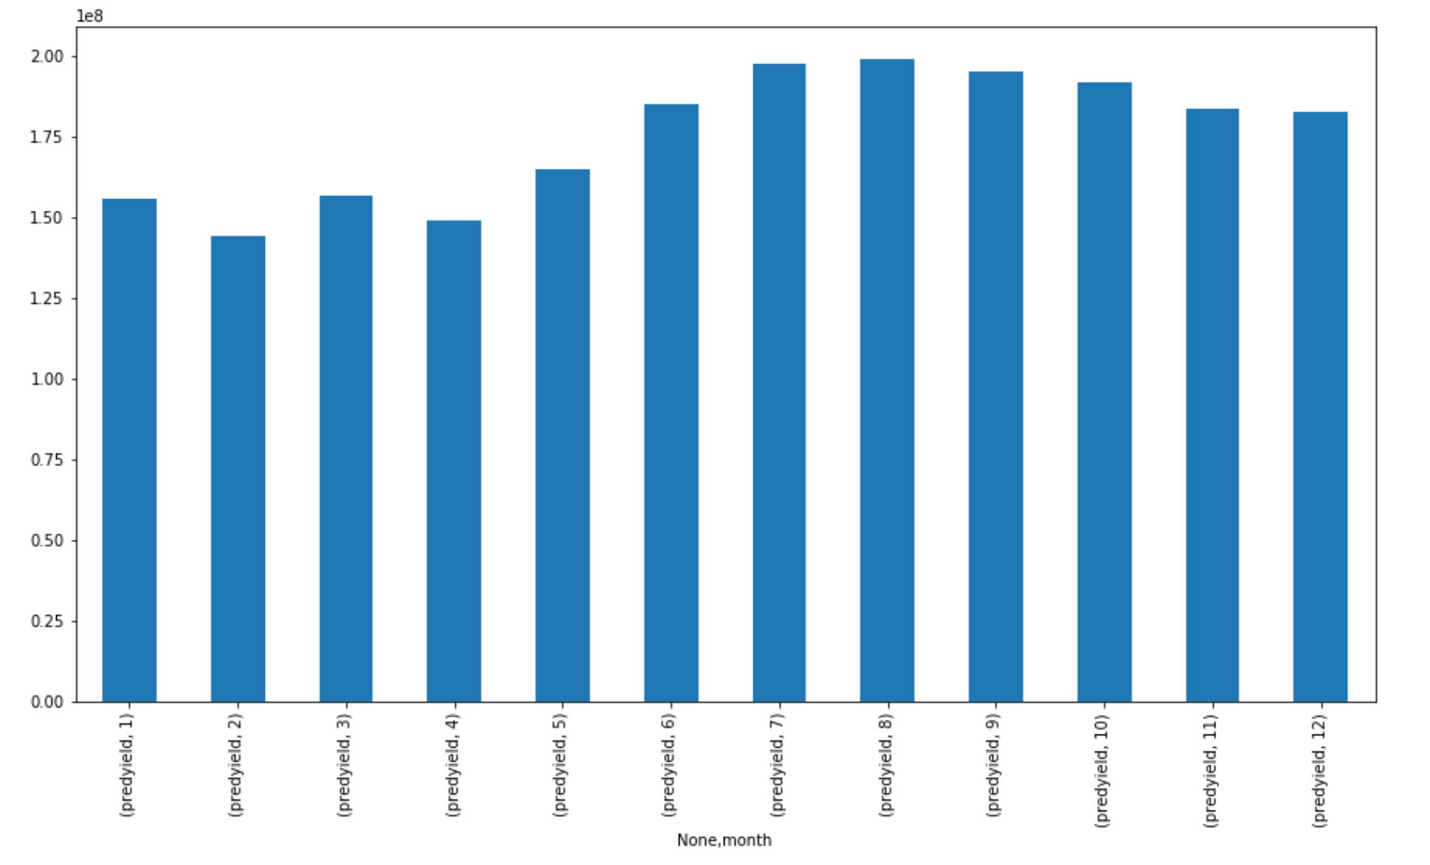
Predicted yield Month-wise

Slide 20
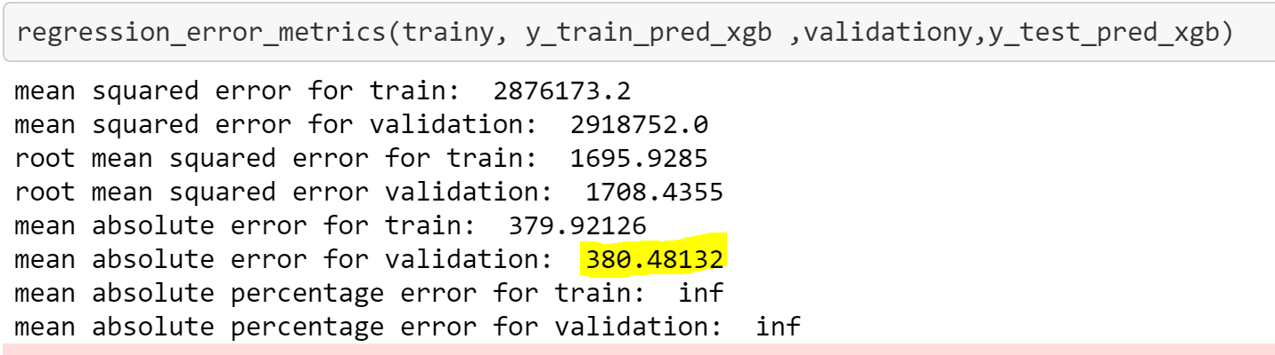
XG BOOSt
Preprocessing: Label Encoding done on columns dayofyear, day and hour
MAE value for XG Boost is 380.48132

Slide 21
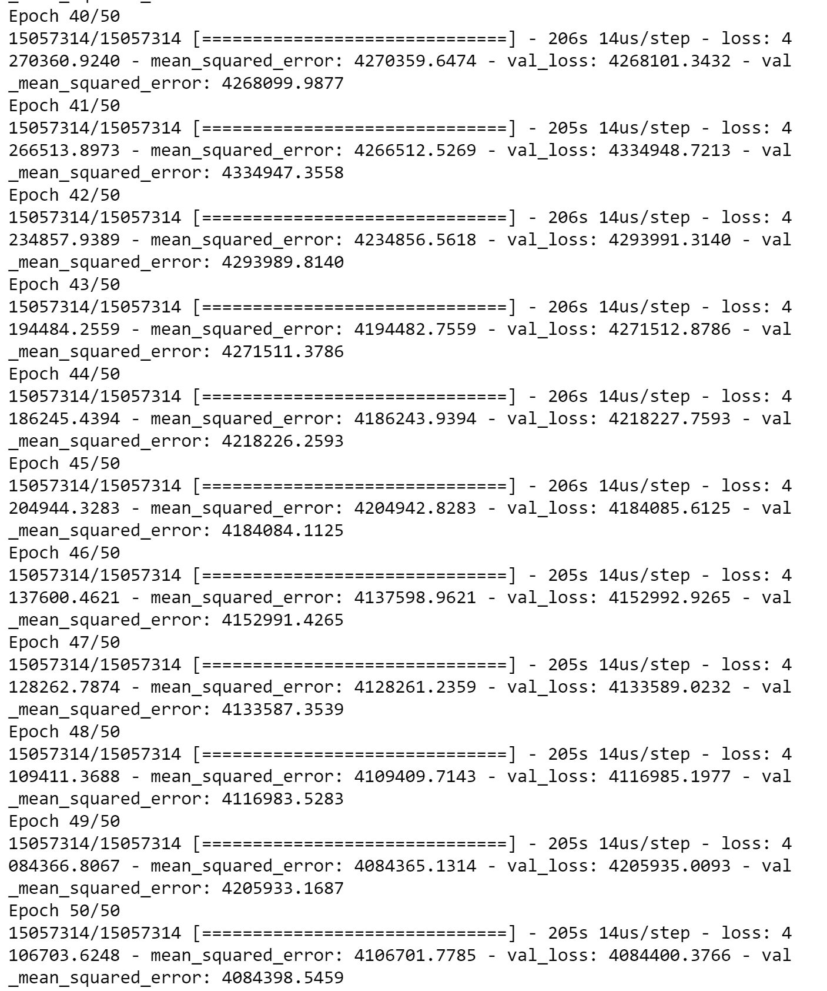
Neural Network
Mean squared Error is 4084398.5459

Slide 22
Comparison of Models
 | Linear Regression | Decision Tree without outliers | Decision Tree with Hyperparameter | Random Forest | XG Boost | Neural Networks
Train | 2277.8 | 9.49 | 755.37 | 771.49 | 1695.92 | 4106701.77
Validation | 2302.14 | 887.7 | 890.9 | 814.85 | 1708.43 | 4084398.54
Test | NA | NA | 3140.43 | NA | NA | NA

Slide 23
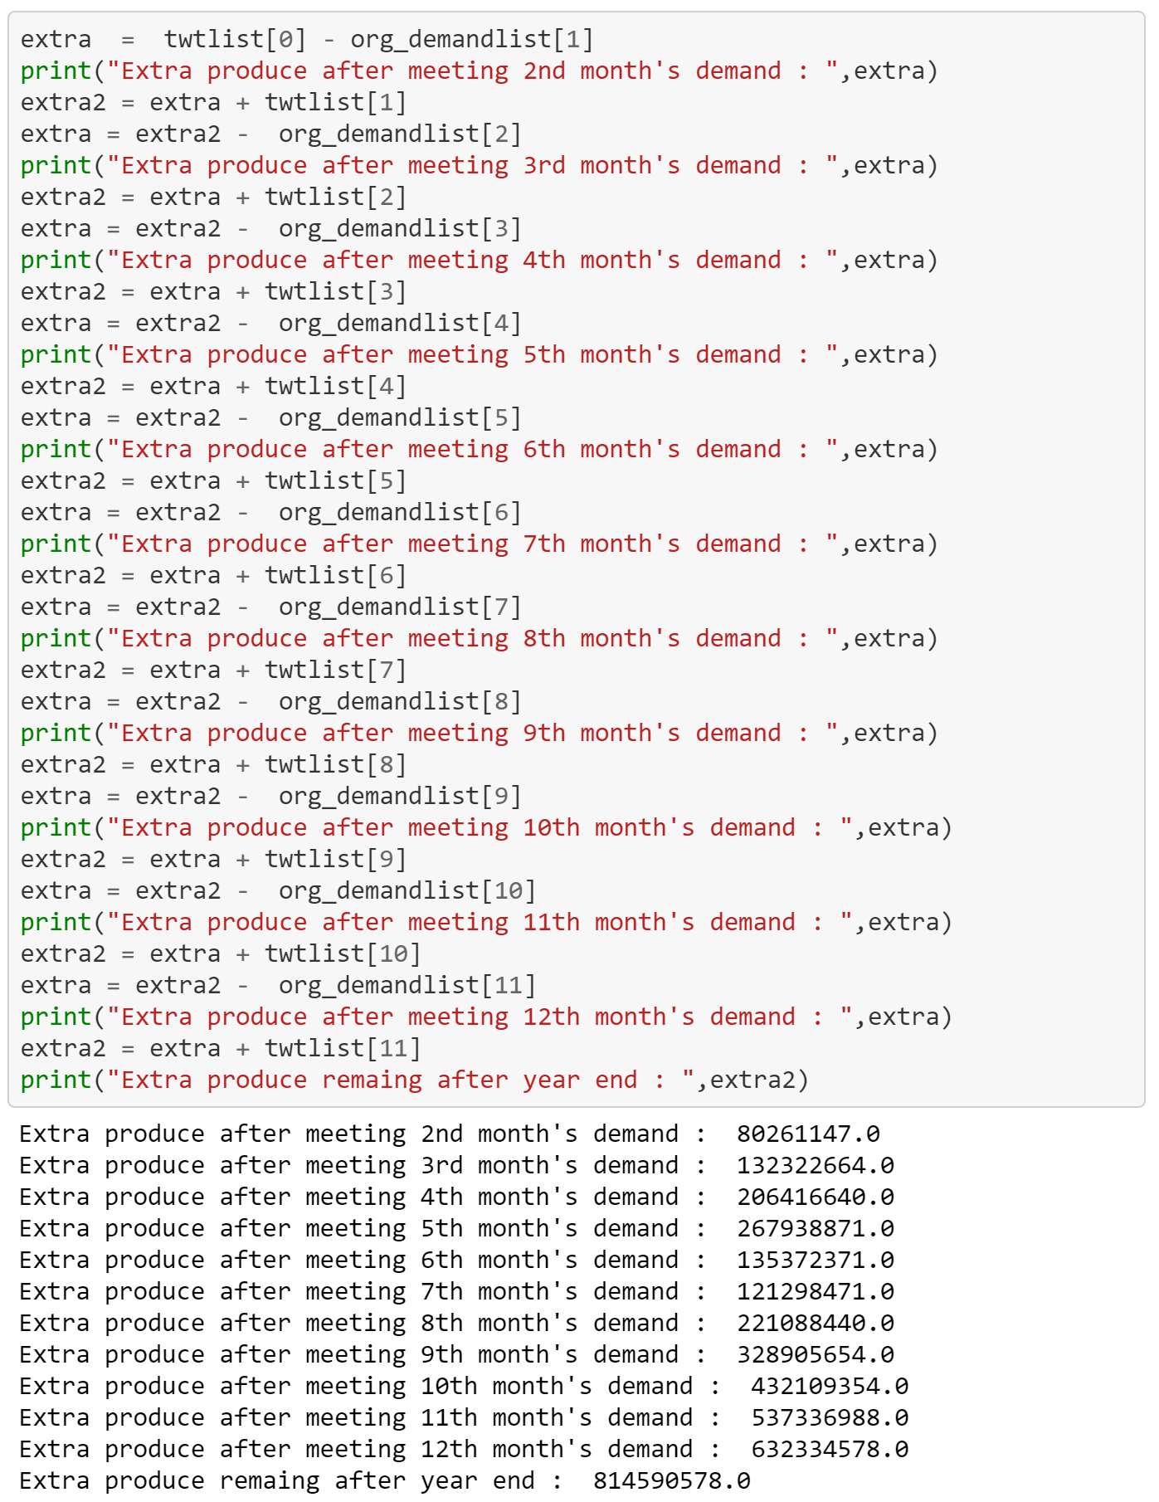
Yield Produced actual vs Original demand

Slide 24
CONCLUSION
Decision Tree is the best suited model, among the compared model.
Yield produced monthly is more than sufficient for consumption
Extra yield produced can be stored future consumption.

Slide 25
THANK YOU

